Slide 1
Information Visualization
A visualization project by:
Abidullah Bin Junaid
Dilip Dwarakanath
Samartha Prakash

Slide 2
Abstract
Our project is based on air crashes from 1908 to 2015.
There have been at least 5,000 crashes since then.
These crashes have happened all across the globe
The crashes have caused varying rates of fatalities and damages

Slide 3
Our Mission
What we aim to do in this project is to find out and visualize where majority of these crashes have happened.
We can from that find, out which routes are the safest with respect to:
Casualty rate
Crash rate
We can also find out which airline was involved in most crashes and which airline has a higher crash rate (Helps if you’re travelling next time!)

Slide 4
Data Gathering
We retrieved the dataset from https://goo.gl/VGr5z9
To be able to use it as input for our visualization, we put it in CSV format.
The dataset has many variables, but we chose only a few of them that we’ll need for this visualization
We’ve chosen Location, Route, Flight, Causalities and Date.

Slide 5
Geo Visualization
It is an approach to applying statistical analysis and other analytic techniques to data which has a geographical or spatial aspect.
Such analysis would typically employ software capable of rendering maps processing spatial data, and applying analytical methods to terrestrial or geographic datasets, including the use geographic information systems.

Slide 6

Visualization So Far…
We tried to render a world map using a solid sphere(using orthographic projection).

Slide 7

Inserting the world map
Wrapping the flat world map around the globe we were able to make a globe.

Slide 8
GeoJSON and TopoJSON
GeoJSON is an open standard format designed for representing simple geographical features, along with their non-spatial attributes, based on JavaScript Object Notation.
TopoJSON is an extension of GeoJSON that encodes topology. Rather than representing geometrics discretely, geometrics in TopoJSON files are stitched together from shared line segments called arcs.
Arcs are sequences of points, while line strings and polygons are defined as sequences of arcs. Each arc is defined only once, but can be referenced several times by different shapes, thus reducing redundancy and decreasing the file size.

Slide 9
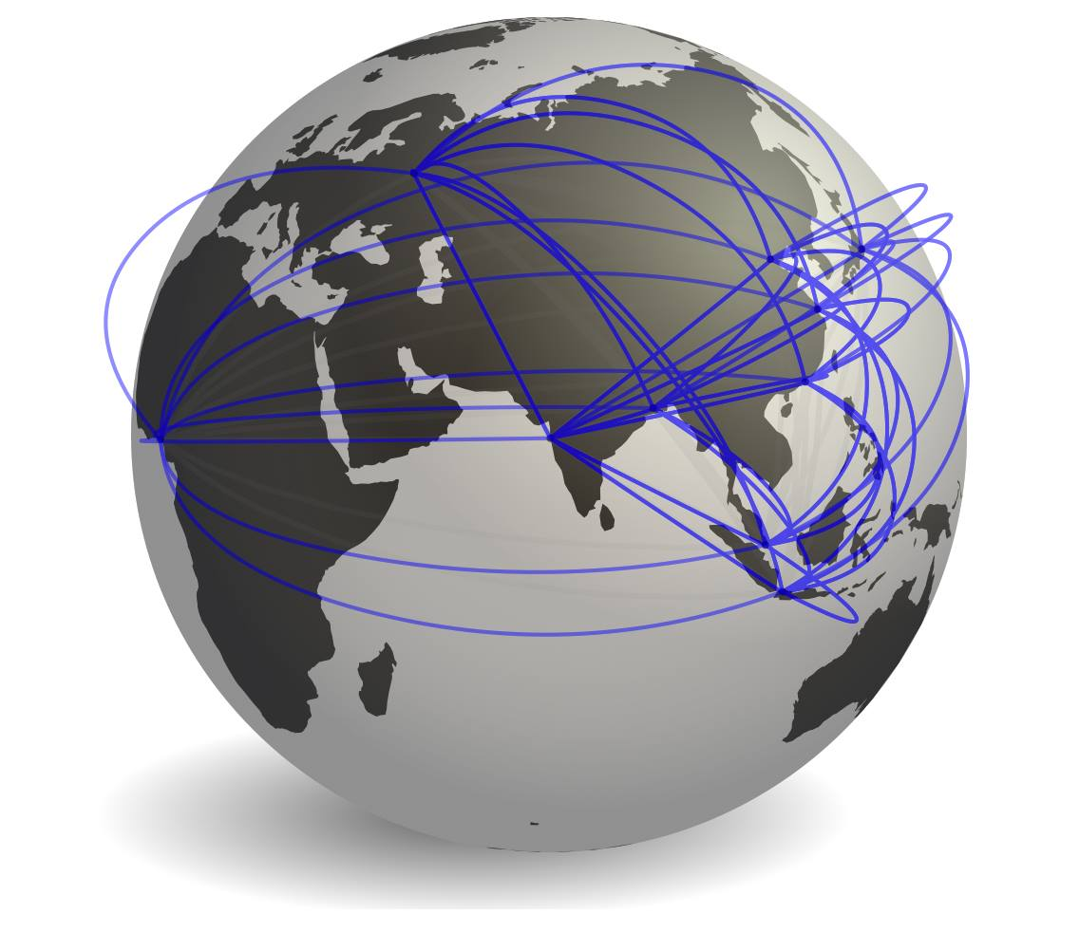
Using the Faux-3D Arc Template
We have used the Faux-3D Arc open source project on Github to render the arcs
This was achieved by using fake 3d svg arcs on the orthographic projections.

Slide 10
Final Output
We will be trying to insert MouseOver function to display the respective information when the mouse pointer is focused on the arc.

